Slide 1

Time Series Analysis on Sales Data

Slide 2

Agenda
Business Analysis.
Technical Analysis.

Slide 3
Business Analysis

Slide 4
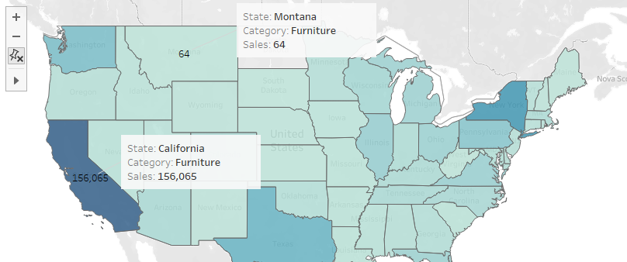
TSA on sales Data
California has more Furniture sales
Montana has least Furniture sales

Slide 5
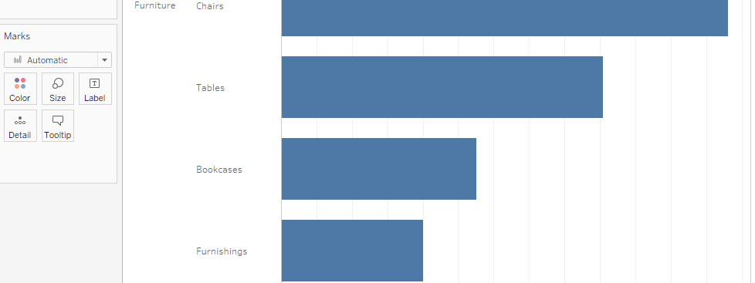
TSA on sales Data
There are 4-Sub categories of Furniture in California.

Slide 6
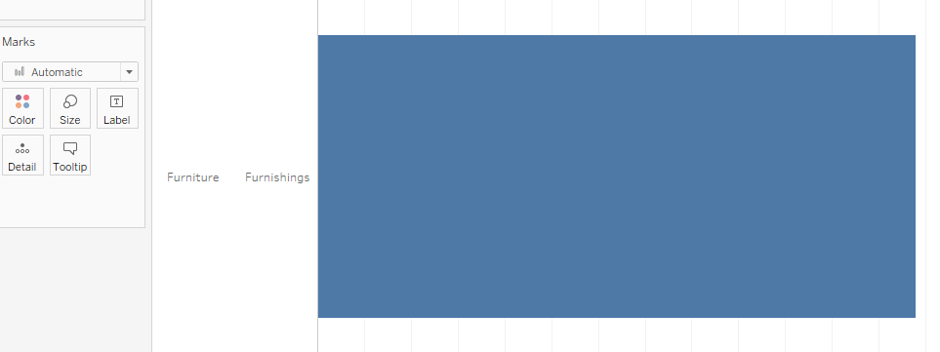
TSA on sales Data
There is only a 1-Sub category of Furniture in Montana.

Slide 7
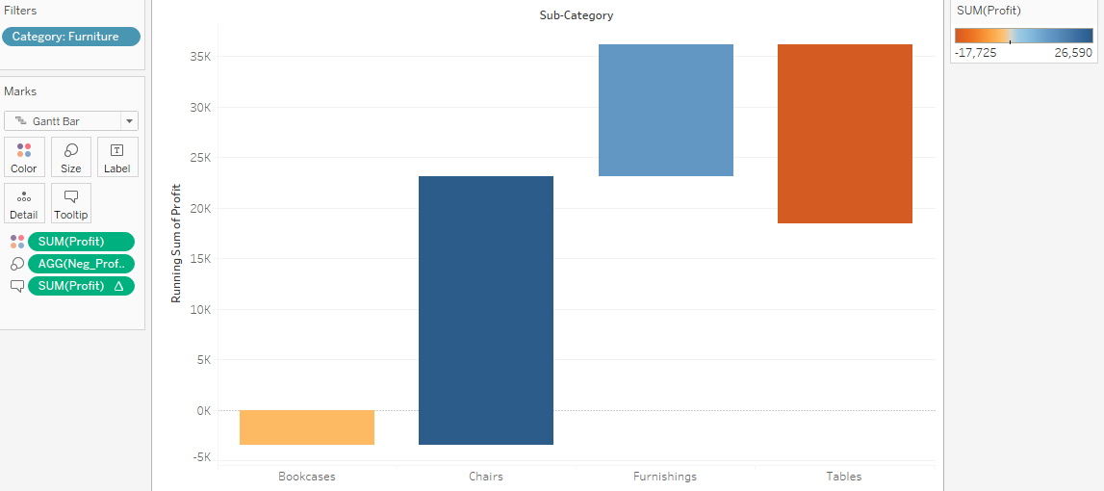
TSA on sales Data
Table and Bookcases sub-category has faced loss. The Table sub-category has more loss.
Chairs and Furnishings sub-category has profit in which Chairs is having more profit.

Slide 8
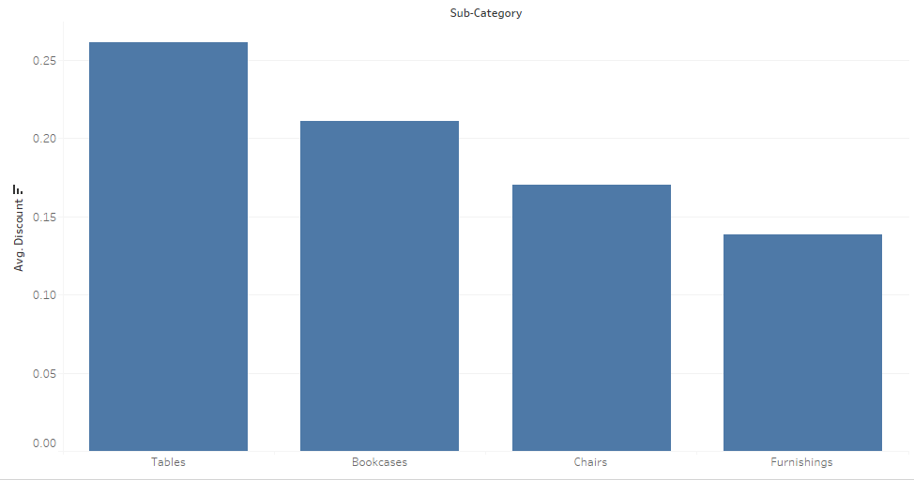
TSA on sales Data
Table and Bookcases have more discount than any other that is, why there is loss.

Slide 9
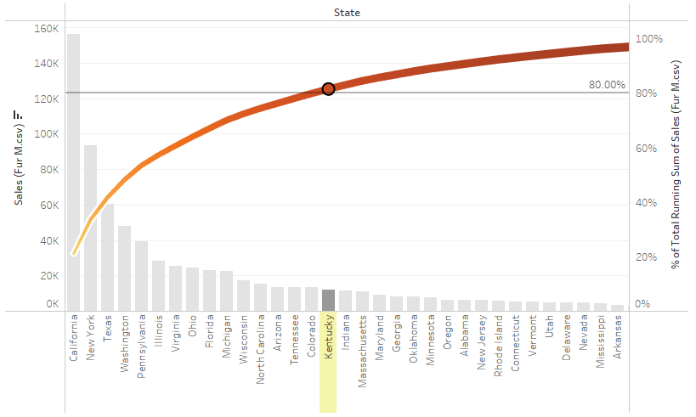
TSA on sales Data
Applying business strategies only for 16 states sales can be increased by 80%

Slide 10
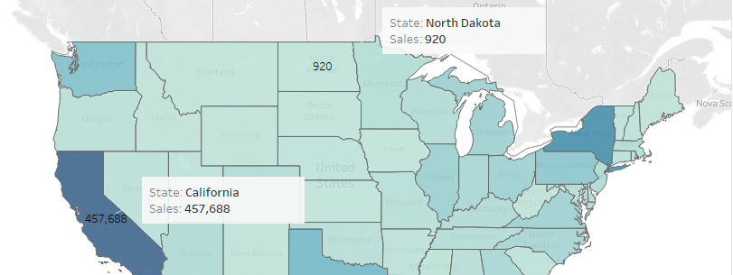
TSA on sales Data
California has more sales
North Dakota has least sales

Slide 11
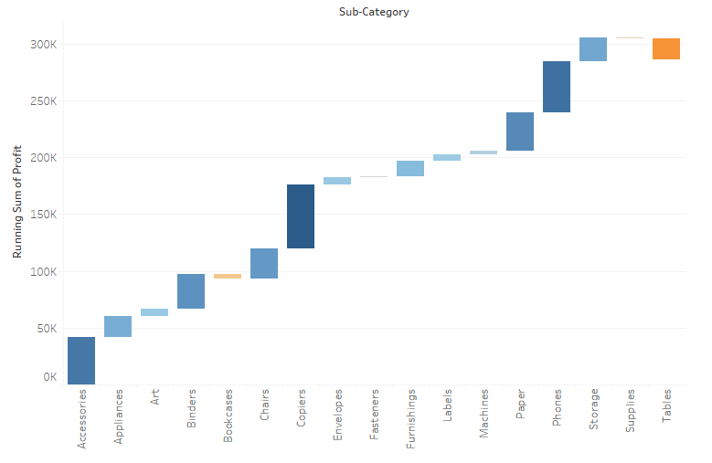
TSA on sales Data
Table Bookcases and supplies sub-category has faced loss. The Table sub-category has more loss.

Slide 12
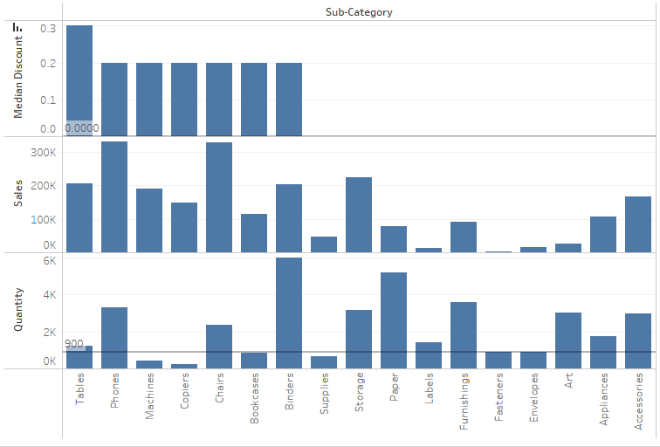
TSA on sales Data
For now, for Every Subcategory with less than 900 Quantities, giving Discounts can increase the profit.

Slide 13
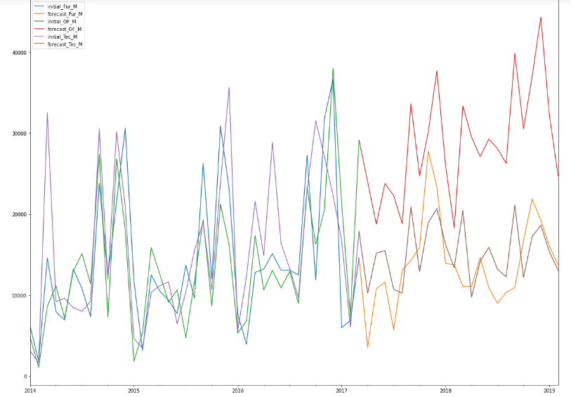
TSA on sales Data
Furniture Sales and Technology sales is decreased over the years.
Office Sales are Increasing over the years compared to past timestamps.

Slide 14
Suggestion
Since, Furniture Sales are least in Montana they Can be increased by Selling chairs, tables, and bookcases at a reasonable discount.
In the Overall profit scenario, Table and Bookcases are contributing loss to overcome this Discount rate should be decreased.
If this suggestion is considered just for 16 states then 70 to 80% of Sales will be increased and loss will be compensated to some good extent.

Slide 15
Technical analysis Click here

Slide 16
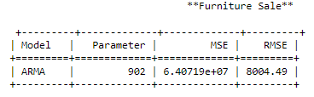
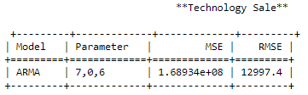
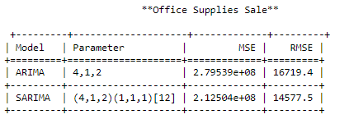
TSA on sales Data

Slide 17
TSA on sales Data

Slide 18
THANK you
TSA OF SALES DATA

